Slide 1
Object-Oriented Programming in Python
Goldwasser and Letscher
Chapter 3
Getting Started with Graphics

Slide 2
Introduction: Chapter 3 Topics
The canvas.
Drawable objects.
Rotating, Scaling, and Flipping.
Cloning.
Case Study: Smiley Face.
Layers.
Animation.
Graphical User Interfaces (GUI).
Case Study: Flying Arrows.

Slide 3
Canvas Object
paper=Canvas() #paper is a Canvas object
  paper.setBackgroundColor(color) where color is a str such as 'skyBlue'.
  paper.setWidth(width) where width is an int.
  paper.setTitle(title) where title is a str.
Can do same thing with:
  paper=Canvas(width, height, color, title)

Slide 4
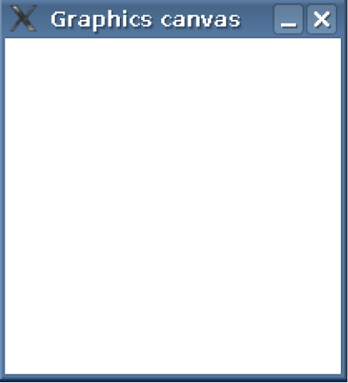
Canvas Object

Slide 5
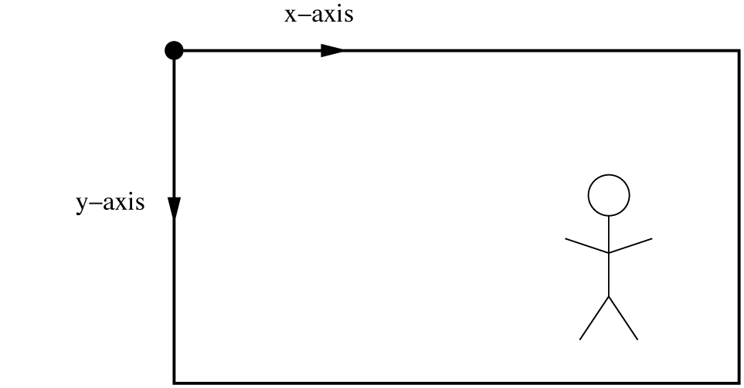
Coordinate System
Coordinate system
  Origin at upper left corner
  X increases to the right.
  Y increases downward. This is backwards from mathematics.

Slide 6
Circle Object
Point(x,y) – point with coordinates x and y
sun=Circle()
  paper.add(sun)
  sun.setRadius(radius) where radius is an int. Default radius is 10.
  sun.setFillColor(color)
  sun.move(x, y) where x and y are ints. Default Circle center is 0 and 0.

Slide 7
Circle Object (continued)
sun=Circle(int radius, Point(int x, int y))
#radius and center of circle when object #created.
paper.add(sun) #places sun on canvas

Slide 8
Drawable Objects
Circle(radius, center_point)
Square(side_length, center_point)
Rectangle(width, length, center_point)
Polygon(point1, point2, point3, . . .)
  addPoint(point, index) index where to insert.
  last Point connected to first point.
Path(point1, point2, . . .) draws line from point to point.
Text and Image Classes.

Slide 9
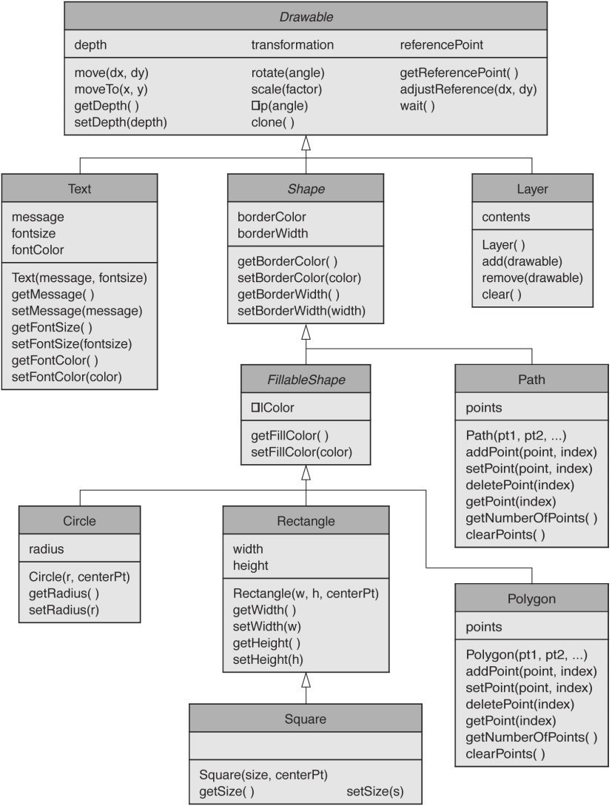
Drawable Objects

Slide 10
Colors and Depths
Predefined colors: help(colors) will give the list of colors.
New colors: a tuple (red, green, blue) where each color can range between 0 and 255. Bright blue would be (0,0,255).
setDepth(int) method can be used on any object. The larger the int the further back. Nearer objects occlude further back objects.

Slide 11

Creating a Graphical Scene
>>> paper = Canvas()
>>> paper.setBackgroundColor('skyBlue')
>>> paper.setWidth(300)
>>> paper.setTitle('My World')
>>> sun = Circle()
>>> paper.add(sun)
>>> #sun has center at
>>> #coordinates 0, 0

Slide 12

Creating a Graphical Scence (continued)
>>> #move sun to correct spot
>>> sun.move(250, 50)
>>> sun.setRadius(30)
>>> sun.setFillColor('yellow')

Slide 13
Creating a Graphical Scence (continued)
>>> #make house
>>> façade = Square(60, Point(140, 130))
>>> façade.setFillColor('white')
>>> paper.add(façade)
>>> #make chimney
>>> chimney = Rectangle(15, 18, Point(155, 85))
>>> chimney.setFillColor('red')
>>> paper.add(chimney)

Slide 14
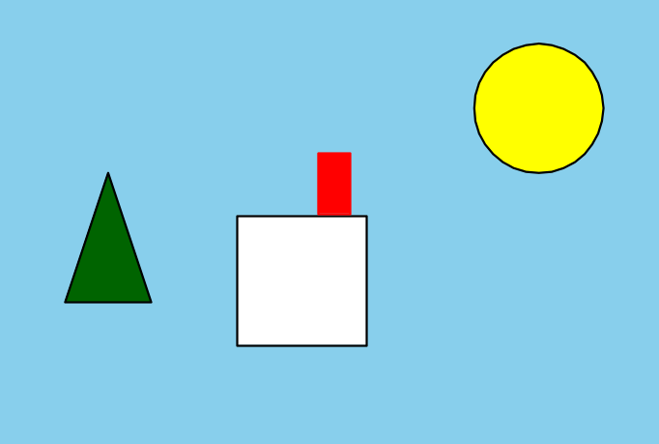
Creating a Graphical Scence (continued)
>>> #make tree
>>> tree = Polygon(Point(50,80), Point(30,140),
Point(70, 140))
>>> tree.setFillColor('darkGreen')
>>> paper.add(tree)

Slide 15
Creating a Graphical Scence (continued)
>>> smoke = Path(Point(155,70),Point(150,65),
Point(160,55),Point(155,50))
>>> paper.add(smoke)
>>> sunraySW = Path(Point(225,75),
Point(210,90))
>>> sunraySW.setBorderColor('yellow')
>>> sunraySW.setBorderWidth(6)
>>> paper.add(sunraySW)

Slide 16
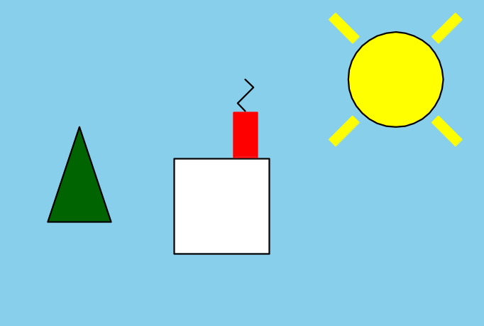
Creating a Graphical Scence (continued)
>>> #make three other sun rays

Slide 17
Complete Code For House
from cs1graphics import *
paper = Canvas(300,200, 'skyBlue', 'My World')
sun = Circle(30, Point(250,50))
sun.setFillColor('yellow')
paper.add(sun)
façade = Square(60, Point(140,130))
façade.setFillColor('white')
paper.add(façade)

Slide 18
Code For House (continued)
chimney = Rectangle(15, 28, Point(155,85))
chimney.setFillColor('red')
chimney.setBorderColor('red')
paper.add(chimney)
tree = Polygon(Point(50,80), Point(30,140),
Point(70,140))
tree.setFillColor('darkGreen')
paper.add(tree)

Slide 19
Code For House (continued)
smoke = Path(Point(155,70),Point(150,65), Point(160,55), Point(155,50))
paper.add(smoke)
sunraySW = Path(Path(225,75), Point(210,90))
sunraySW.setBorderColor('yellow')
sunraySW.setBorderWidth(6)
paper.add(sunraySW)
sunraySE = Path(Path(275,75), Point(290,90))
sunraySE.setBorderColor('yellow')

Slide 20
Code For House (continued)
sunraySE.setBorderWidth(6)
paper.add(sunraySE)
sunrayNE = Path(Path(275,25), Point(290,10))
sunrayNE.setBorderColor('yellow')
sunrayNE.setBorderWidth(6)
paper.add(sunrayNE)
sunrayNW = Path(Path(275,75), Point(290,90))
sunrayNW.setBorderColor('yellow')
sunrayNW.setBorderWidth(6)
paper.add(sunrayNW)

Slide 21
Code For House (continued)
grass = Rectangle(300,80, Point(150,160))
grass.setFillColor('green')
grass.setBorderColor('green')
grass.setDepth(75)
paper.add(grass)
window = Rectangle(15,20, Point(130,120))
paper.add(window)
window.setFillColor('black')
window.setBorderColor('red')
window.setBorderWidth(2)
window.setDepth(30)

Slide 22
Code For House (continued)
roof = Polygon(Point(105,105), Point(175,105),
Point(170,85), Point(110,85))
roof.setFillColor('darkgray')
roof.setDepth(30)
chimney.setDepth(20)
paper.add(roof)

Slide 23
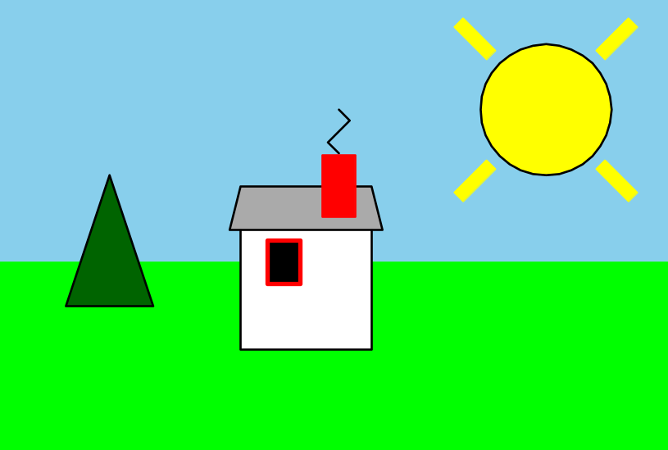
House Graphic Image Completed

Slide 24
#inclass exercise
from cs1graphics import *
can = Canvas(700,700)
can.setBackgroundColor('lightblue')
object = Polygon(Point(10,40),Point(40,40),Point(50,10),
Point(60,40),
Point(90,40),Point(65,60),Point(75,90),Point(50,70),
Point(25,90),Point(35,60))
object.setFillColor('white')
object.setBorderColor('white')
canvas.add(object)

Slide 25
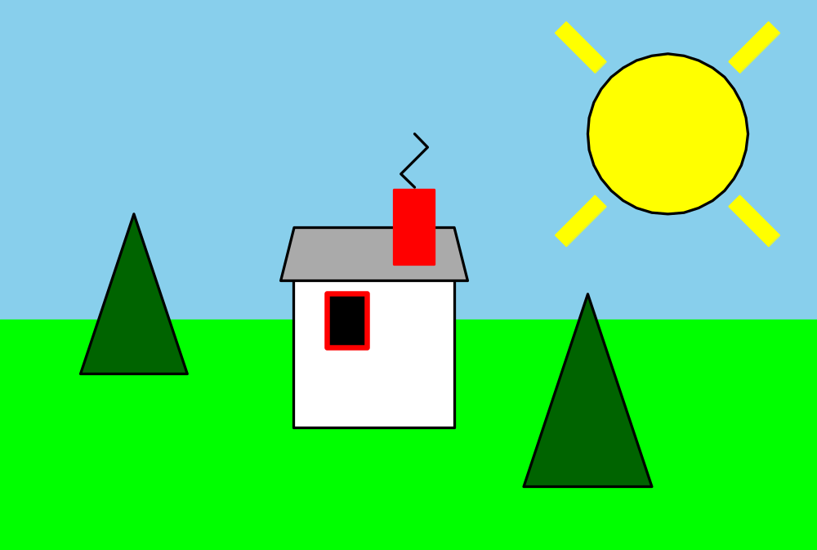
Cloning: Adding a Tree to Previous House Scene

Slide 26
CLONING and SCALING
clone() – method that makes a copy of an object that then can be moved or resized.
scale(factor) #changes size by factor.
Add these lines to the previous code (tree has been defined previously)
otherTree = tree.clone()
otherTree.move(170,30)
otherTree.scale(1.2)
paper.add(otherTree)

Slide 27
Animation
from time import sleep
sleep(time_delay) where time_delay is the time delay in seconds.
cs1graphics automatically updates the screen when ever a change is made.
If many objects are drawn this may cause flicker. May see objects being drawn.

Slide 28
Event and GUI Programming
wait() is a method that can be used on any drawable object or the canvas.
It forces the program to wait on an event.
GUI pronounced gooey stands for Graphical User Interface.

Slide 29
from cs1graphics import *
from time import sleep
can = Canvas(700,700)
can.setBackgroundColor('lightblue')
star= Polygon(Point(10,40),Point(40,40),Point(50,10),
Point(60,40),
Point(90,40),Point(65,60),Point(75,90),Point(50,70),Point(25,90),Point(35,60))
star.setFillColor('white')
star.setBorderColor('white')
star.scale(.25)
can.add(star)

Slide 30
t = Text("click to see star falling")
t.setFontSize(30)
t.moveTo(350,350)
can.add(t)
can.wait()
sleep(.35)
star.move(30,30)
sleep(.35)
star.move(30,30)
sleep(.35)
star.move(30,30)
sleep(.35)
star.move(30,30)
sleep(.35)
star.scale(1.25)
star.move(30,30)
sleep(.35)
star.scale(1.50)
star.move(30,30)
can.wait()
can.close()

Slide 31
Layers
Layer() this serves as a kind of small canvas. Objects can be added to a layer.
It is like a compound drawable object.
It can be moved, resized, rotated, anything that can be done to a drawable object.
Use the add() method for adding items to the layer.

Slide 32
Layers (include car on scene)
car = Layer()
tire1 = Circle(10, Point(-20,-10))
tire1.setFillColor('black')
car.add(tire1)
tire2= Circle(10, PoInt(20, -10))
tire2.setFillColor('black')
car.add(tire2)
body = Rectangle(70,30, Point(0,-25))
body.setFillColor('blue')
body.setDepth(60)
car.add(body)

Slide 33
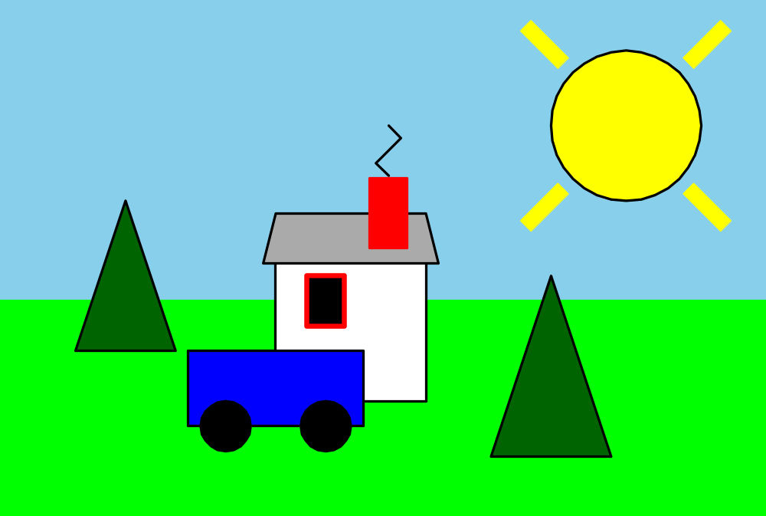
Results of Previous Code

Slide 34
from cs1graphics import *
from time import *
can = Canvas(500,500,'lightBlue')
traffic = Layer()
fram = Rectangle(50,150,Point(400,200))
fram.setFillColor('black')
traffic.add(fram)
redlight = Circle(22,Point(400,150))
redlight.setFillColor('red')
traffic.add(redlight)
yellowlight = Circle(22,Point(400,200))
yellowlight.setFillColor('gray')
traffic.add(yellowlight)
greenlight = Circle(22,Point(400,250))
greenlight.setFillColor('gray')
traffic.add(greenlight)
can.add(traffic)

Slide 35
sleep(1.75)
redlight.setFillColor('gray')
yellowlight.setFillColor('yellow')
sleep(.75)
yellowlight.setFillColor('gray')
greenlight.setFillColor('green')
sleep(1.75)
redlight.setFillColor('red')
greenlight.setFillColor('gray')
sleep(1.75)
redlight.setFillColor('gray')
yellowlight.setFillColor('yellow')
sleep(1.75)
yellowlight.setFillColor('gray')
greenlight.setFillColor('green')
sleep(1.75)
redlight.setFillColor('red')
greenlight.setFillColor('gray')

Slide 36
sleep(1.75)
redlight.setFillColor('gray')
yellowlight.setFillColor('yellow')
sleep(1.75)
yellowlight.setFillColor('gray')
greenlight.setFillColor('green')
can.wait()
can.close()

Slide 37
Event and GUI Programming (continued)
Items on the GUI are called widgets.
Three widgets are:
  TextBox – input for text
  Button – text and clickable area
  Text – allows text to be displayed.
An example of code using TextBox, Button and Text widgets is shown on the next slide.

Slide 38
Widget Code
from cs1graphics import *
paper = Canvas()
nameInput = TextBox(150, 30, Point(100,40))
paper.add(nameInput)
submit = Button('Enter name', Point(100,80))
paper.add(submit)
submit.wait()
welcome = Text('Hello, ' + nameInput.getMessage())
welcome.move(100, 150)
paper.add(welcome)

Slide 39
Rotating and Scaling
rotate(degrees) #rotation around the center point
adjustReference(x, y) #changes point of rotation
#by relative amounts x and y.
scale(factor) #changes size by factor.
#Uses center point if not otherwise told.
Can use adjustReference() to change point of scaling as well as rotation point.

Slide 40
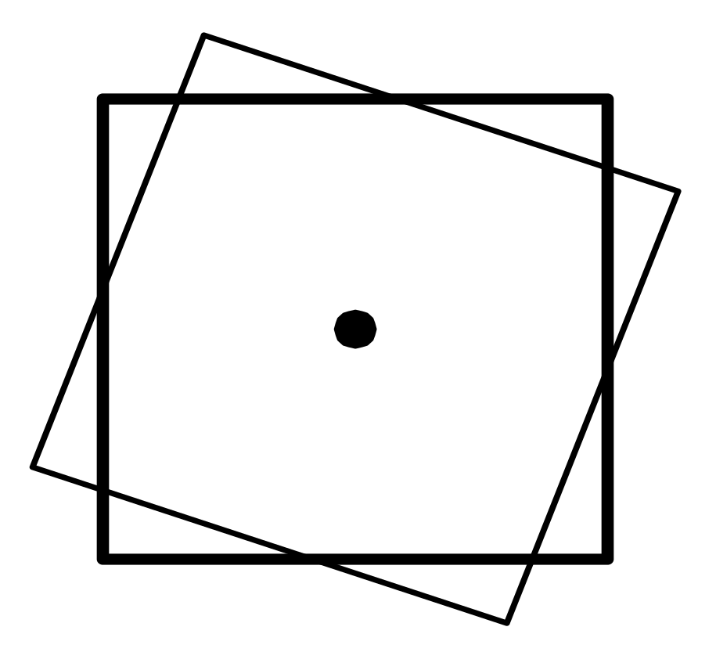
Rotating Figure: Around Center

Slide 41
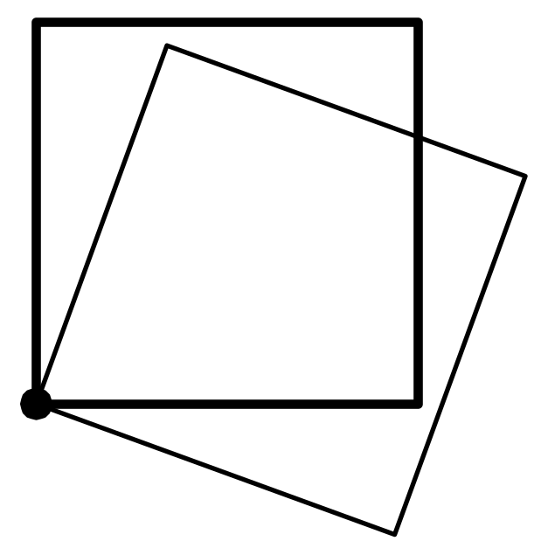
Rotating Square Around a Point Other than the Center

Slide 42
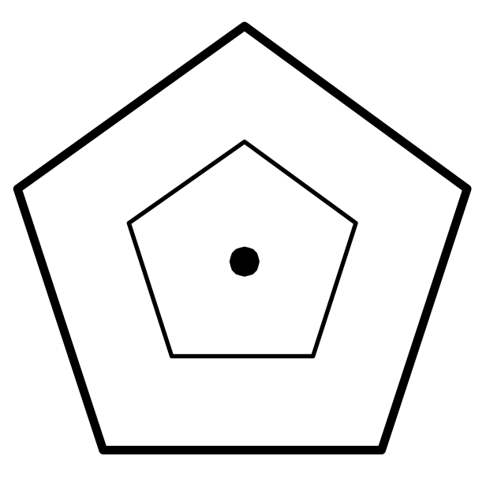
Scaling Figure: Around Center

Slide 43
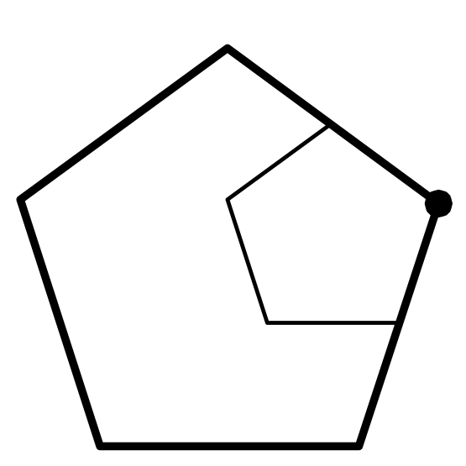
Scaling Around a Point Other Than the Center

Slide 44
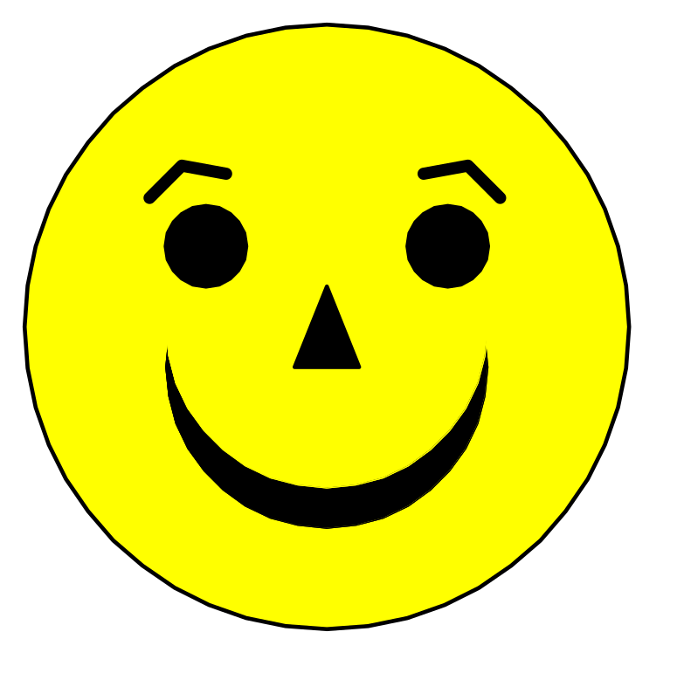
Smiling Face Figure

Slide 45
Case Study: Smiley Face
from cs1graphics import *
paper = Canvas()
head = Circle(75, Point(100,100))
head.setFillColor('yellow')
head.setDepth(60)
paper.add(head)
mouth = Circle(40, Point(100,100))
mouth.setFillColor('black')
mouth.setBorderWidth(0)

Slide 46
Case Study: Smiley Face
(continued)
mouth.setDepth(52)
paper.add(mouth)
mouthCover = Circle(40, Point(100,100))
mouthCover.setFillColor('yellow')
mouthCover.setBorderWidth(0)
mouthCover.setDepth(51)
paper.add(mouthCover)

Slide 47
Case Study: Smiley Face
(continued)
nose = Polygon(Point(100,90),Point(92,110),
Point(108,110))
nose.setFillColor('Black')
paper.add(nose)
leftEye = Circle(10, Point(70,80))
leftEye.setFillColor('black')
paper.add(leftEye)

Slide 48
Case Study: Smiley Face
(continued)
rightEye = Circle(10, Point(130,80))
rightEye.setFillColor('black')
paper.add(rightEye)
leftEyebrow=Path(Point(60,65),Point(70,60),
Point(80,65))
leftEyebrow.setBorderWidth(3)
leftEyebrow.adjustReference(10,15)
leftEyebrow.rotate(-15)
paper.add(leftEyebrow)

Slide 49
Case Study: Smiley Face
(continued)
rightEyebrow=leftEyebrow.clone()
rightEyebrow.flip()
rightEyebrow.moverotate(60,0)
paper.add(rightEyebrow)

Slide 50
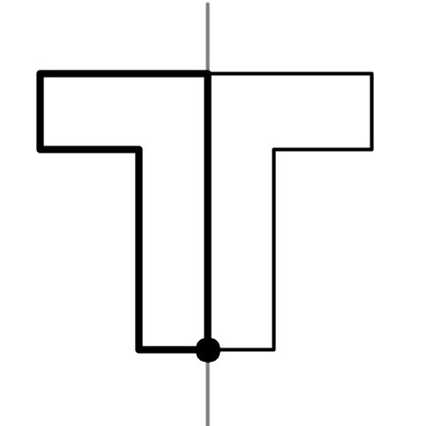
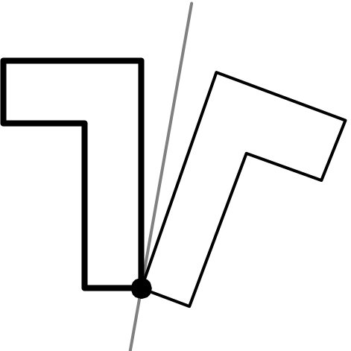
Flipping
Flip arround an axis.
Default is vertical axis.
Top figure is default.
Dark one is original.
Bottom figure: flip(10)
Axis 10 degrees from vertical.

Slide 51
Flipping
flip() - method performs a mirror image of object around vertical axis.
flip(degrees) - method performs a flip around vertical axis that has been rotated in a clockwise manner in degrees.

Slide 52
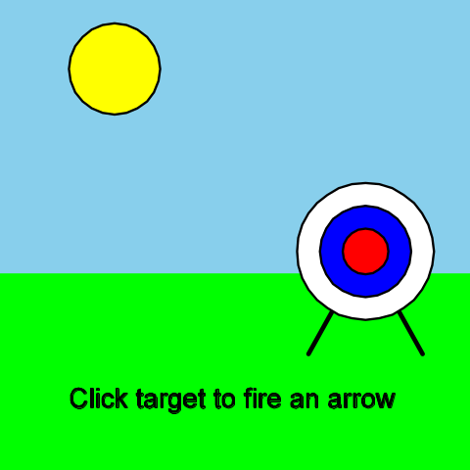
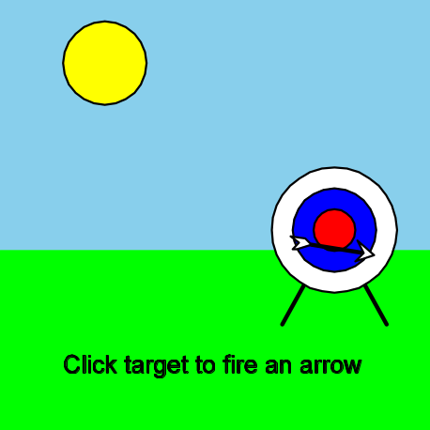
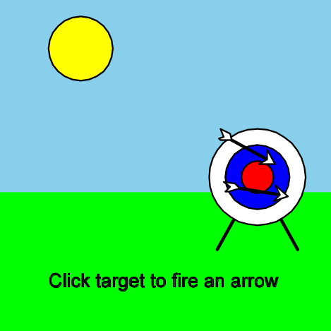
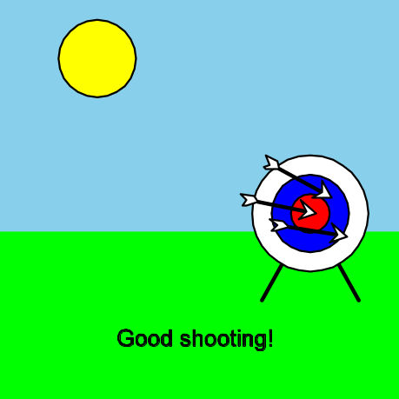
Arrows

Slide 53
Case Study: Flying Arrows
from cs1graphics import
from time import sleep
scene = Canvas()
scene.setBackgroundColor('skyBlue')
grass = Rectangle(200,80, Point(100,160))
grass.setFillColor('green')
grass.setDepth(100)
scene.add(grass)
sun = Circle)(20, Point(50,30))
sun.setFillColor('yellow')
scene.add(sun)

Slide 54
Flying Arrows (continued)
target = Layer()
outside=Circle(30)
outside.setFillColor('white')
outside.setDepth(49)
target.add(outside)
middle = Circle(20)
middle.setFillColor('blue')
middle.setDepth(48)
target.add(middle)
inside = Circle(10)
inside.setFillColor('red')
target.add(inside)

Slide 55
Flying Arrows (continued)
legs = Path(Point(-25,45), Point(0,0),Point(25,45)
legs.setBorderWidth(2)
target.add(legs)
target.move(160,110)
target.setDepth(75)
scene.add(target)
#prepare 3 arrows but do not yet add to scene
arrow1 = Layer()
tip = Polygon(Point(0,0), Point(-8,5), Point(-5,0),
Point(-8,5))
tip.setFillColor('white')
arrow1.add(tip)

Slide 56
Flying Arrows (continued)
shaft = Path(Point(-30,0),Point(-5,0))
shaft.setBorderWidth(2)
shaft.setDepth(51)
arrow1.add(shaft)
fletching=Polygon(Point(-30,0),Point(-33,-3),
Point(-40,-3),Point(-36,0),
Point(-38,3),Point(-36,3))
fletching.setFillColor('white')
arrow1.add(fletching)
arrow2 = arrow1.clone()
arrow3 = arrow3.clone()
target.wait() #wait indefinitely for user event on target

Slide 57
Flying Arrows (continued)
scene.add(arrow1)
arrow1.rotate(-20)
sleep(0.25)
arrow1.move(41,-15)
arrow1.rotate(7)
sleep(0.25)
arrow1.move(41,-5)
arrow1.rotate(7)
sleep(0.25)
arrow1.move(41,5)
arrow1.rotate(7)

Slide 58
Flying Arrows (continued)
sleep(0.25)
arrow1.move(41,17)
arrow1.rotate(7)
target.wait() #wait for user event on target
scene.add(arrow2)
arrow2.rotate(-40)
sleep(0.25)
arrow2.move(39,-22)
arrow2.rotate(17)
sleep(0.25)
arrow2.move(39,-12)

Slide 59
Flying Arrows (continued)
arrow2.rotate(17)
sleep(0.25)
arrow2.move(39,3)
arrow2.rotate(17)
sleep(0.25)
arrow2.move(39,13)
arrow2.rotate(17)
scene.add(arrow3)
arrow3.rotate(-30)
sleep(0.25)

Slide 60
Flying Arrows (continued)
arrow3.move(37,-26)
arrow3.rotate(10)
sleep(0.25)
arrow3.move(37,-11)
arrow3.rotate(10)
sleep(0.25)
arrow3.move(37,6)
arrow3.rotate(10)
sleep(0.25)
arrow3.move(37,21)
arrow3.rotate(10)

Slide 61
Flying Arrows (continued)
dialogue.setMessage('Good shooting!')
scene.wait() #wait for user event anywhere on canvas
scene.close()

